Slide 1

Modeling Human Perceptual Inference by Drift Diffusion Model and Neural Network
Group B - (Dataset 3)
Sajjad Rezvani khaledi, Faezeh Sarlakifar, Leou Ying, Rodrigo Jhampier Cáceres
TAs: Alaz Aydin, Shashwati Tripathi
Mentor: Jeff Erlich
Notes:
Entered text
Here is a brief overview of the drift diffusion model:
The drift diffusion model is a model of decision making that describes the process of accumulating evidence over time until a decision threshold is reached. It assumes that when we make simple two-choice decisions, evidence accumulates noisily over time towards one choice or the other.
The key components of the model are:
Starting point (z) - this represents any initial bias towards one decision over the other before any evidence is accumulated. It is positioned between two decision thresholds.
Drift rate (v) - this quantifies the average rate of evidence accumulation towards one choice over time. A larger positive drift rate means evidence is accumulating faster for one choice over the other.
Decision thresholds (a and 0) - these represent the amount of evidence needed to make a decision. When evidence reaches the upper or lower threshold, a decision is made.
Noise (s) - this reflects the variability/randomness in the evidence accumulation process.
As evidence accumulates over time, the accumulation process is modeled as a random walk with drift towards a threshold. The time taken to reach a threshold and which threshold is reached first determines the decision made and response time.
Key predictions of the model are that decisions with higher drift rates are made faster and more accurately. It also predicts a speed-accuracy tradeoff - with higher decision thresholds, decisions are made more slowly but with greater accuracy.
The model has been very influential in modeling perception, memory, and neuroscience applications involving two-choice decisions. Overall, it provides a simple quantitative framework for evidence accumulation and decision making.

Slide 2


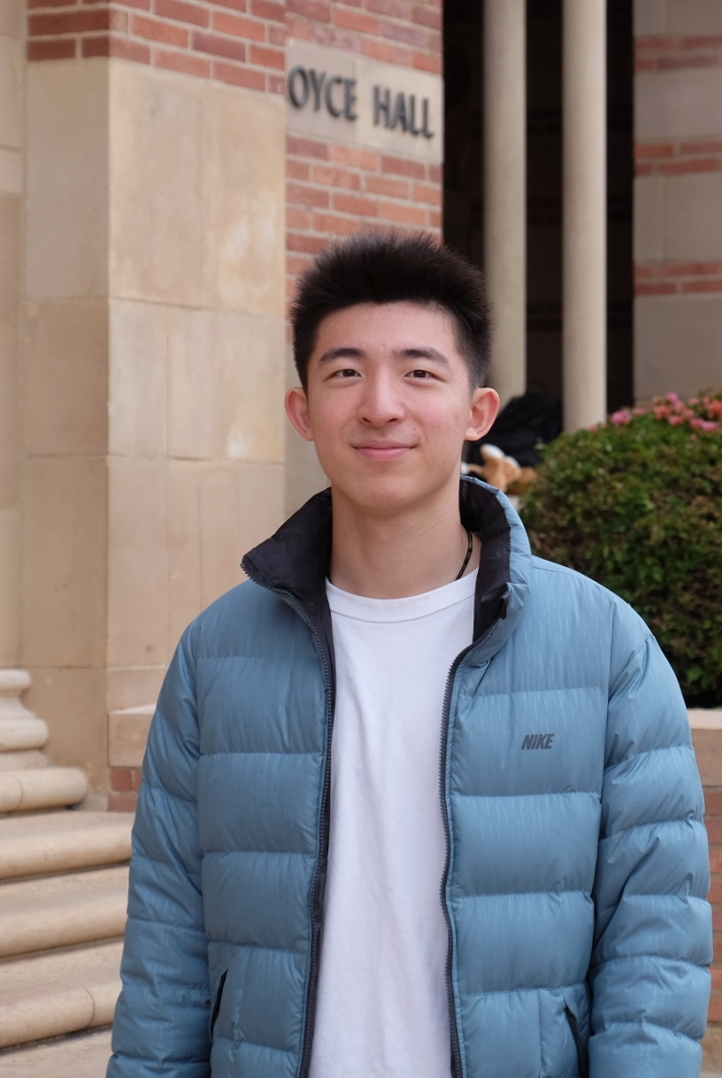
Leou Ying Neuroscience Undergraduate Student
Faezeh Sarlakifar Computer Engineering Undergraduate Student
Sajjad Rezvani Khaledi Electrical Engineering student

Slide 3
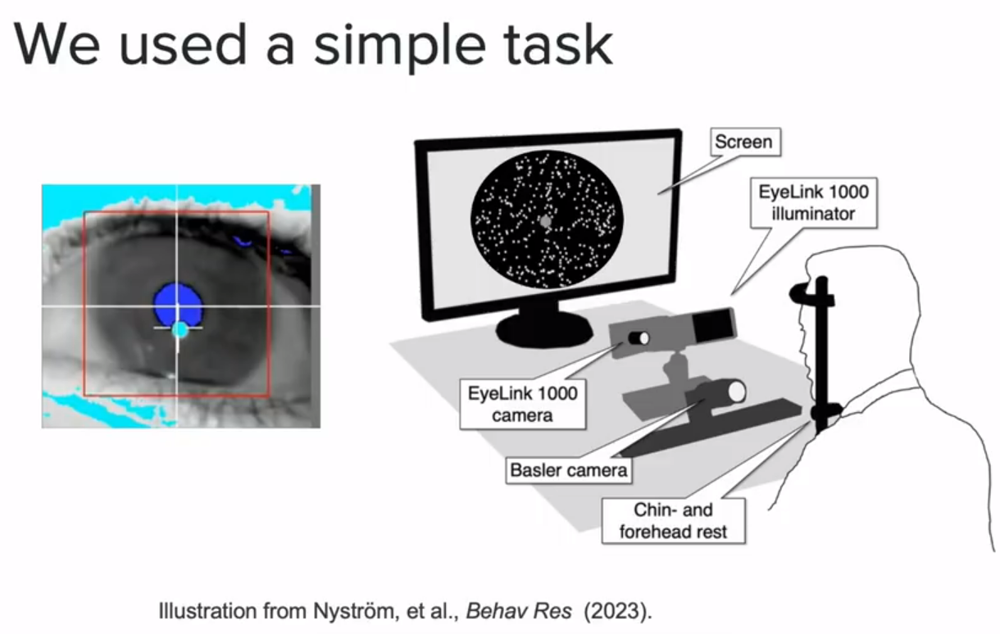
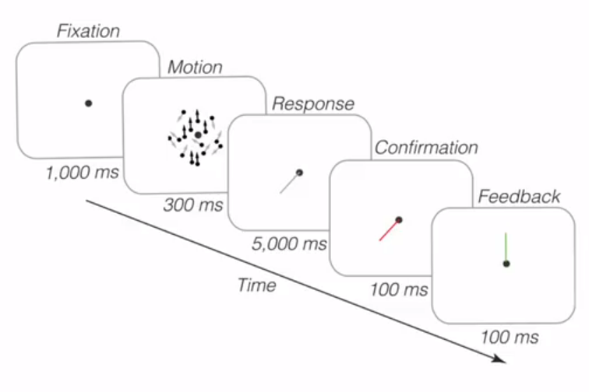
The Switching Observer
Laquitaine & Gardner found evidence for the “Switching Observer” (dataset 3 :Laquitaine & Gardner 2017)

Slide 4
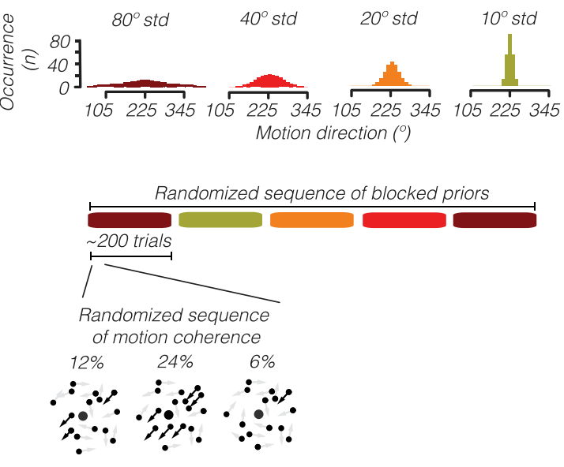
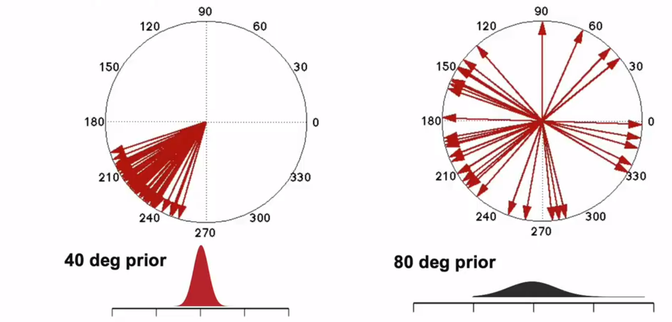
Example Priors

Slide 5
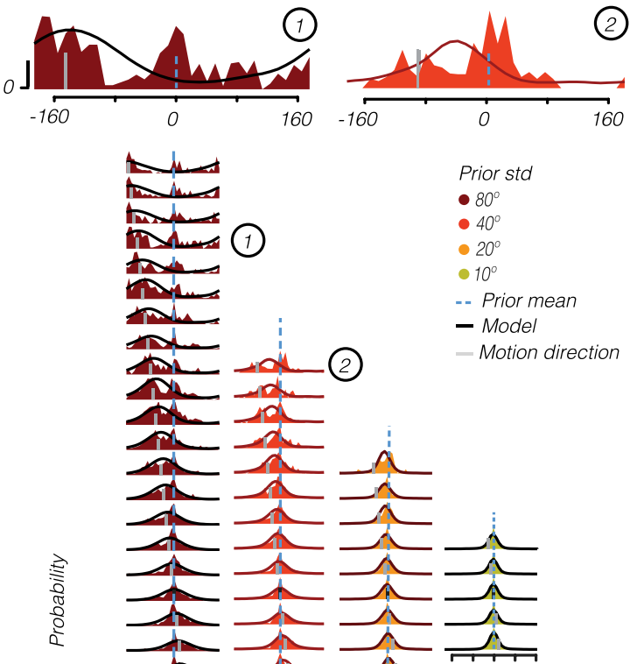
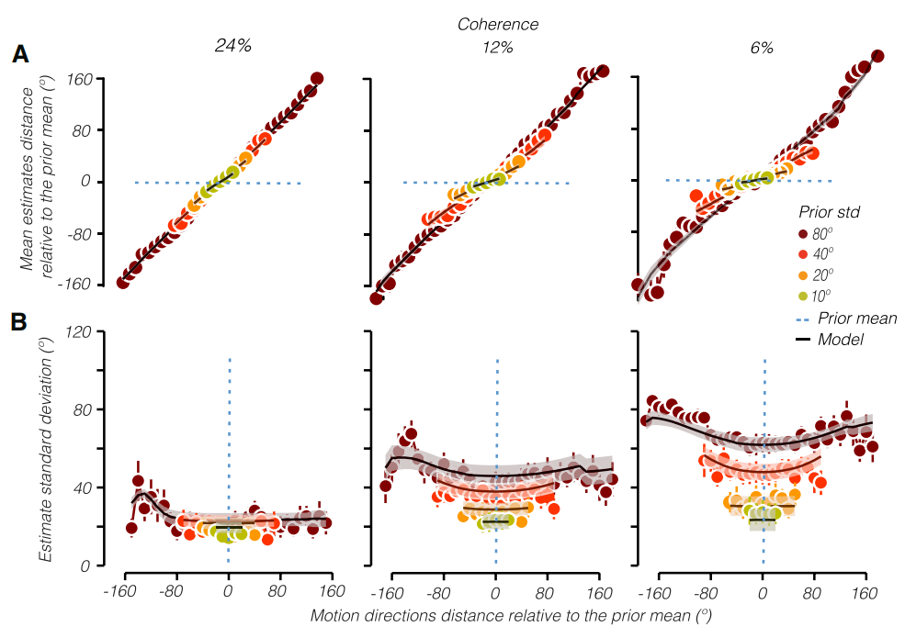
DataSet plot

Slide 6
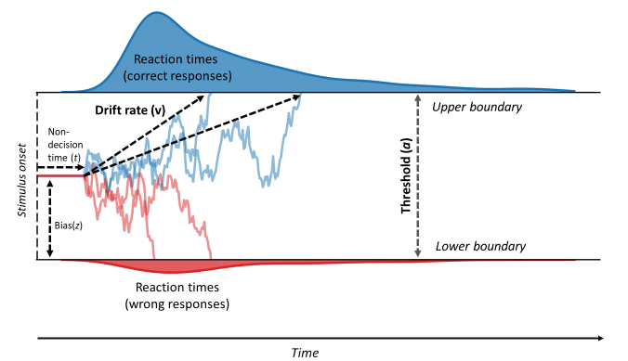
The Switching Observer
We hypothesized that this switch process could be modelled by a Drift-Diffusion model, which may tell us about a relationship between this switch and the reaction time.
(Mikkel C Vinding et al.)

Slide 7
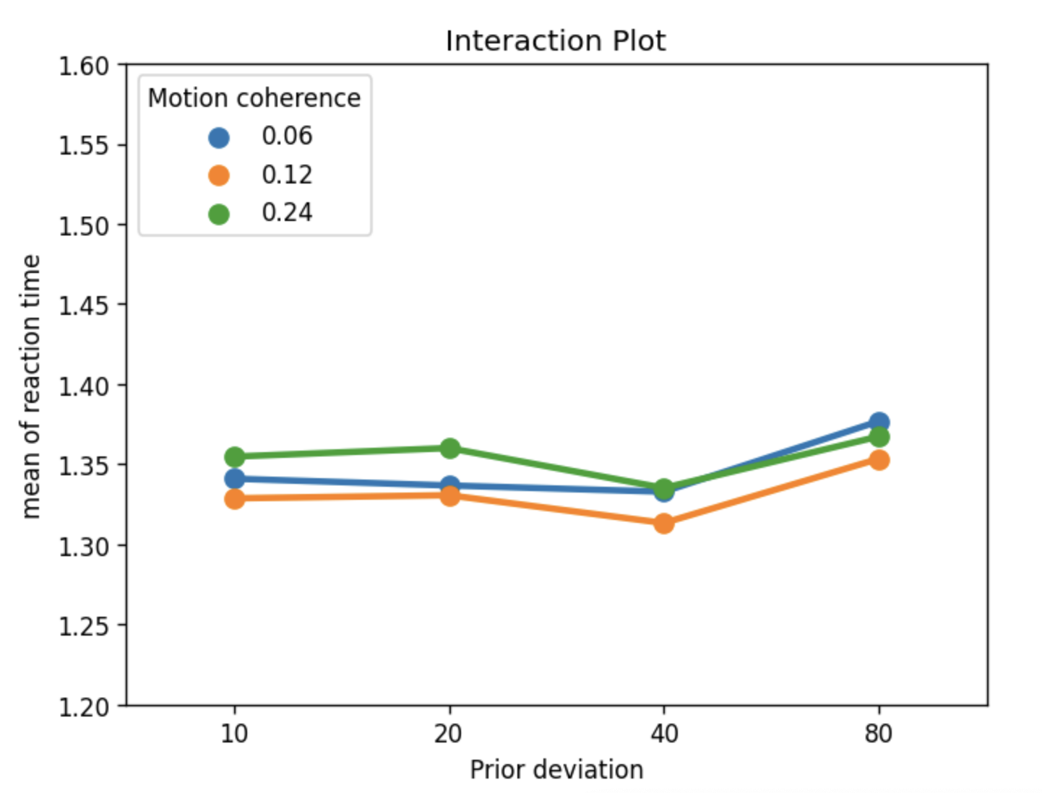
Reaction Time in the dataset
In the data, we examined:
Reaction Time v.s. Motion Coherence
Reaction Time v.s Standard deviation
Reaction time wrt prior-likelihood proximity to estimation
Reaction time wrt start-angle proximity to estimation
Reaction time wrt start-angle proximity to prior/likelihood

Slide 8
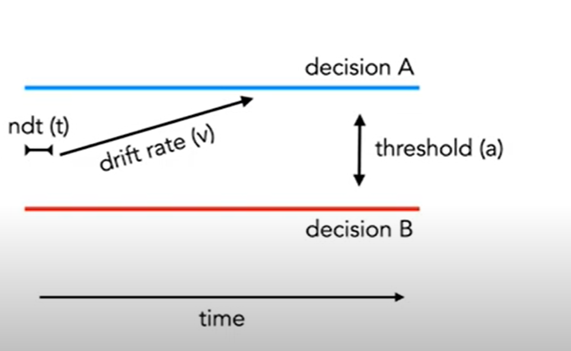
The Drift Diffusion Model (DDM)

Slide 9
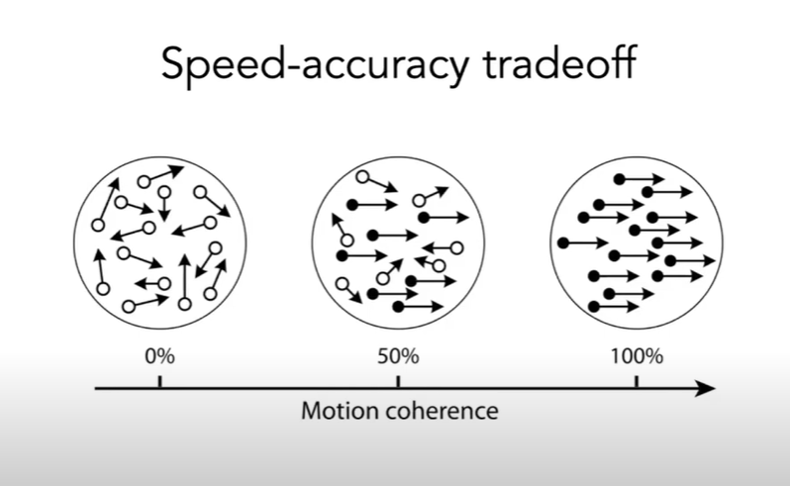
The Drift Diffusion Model (DDM)

Slide 10
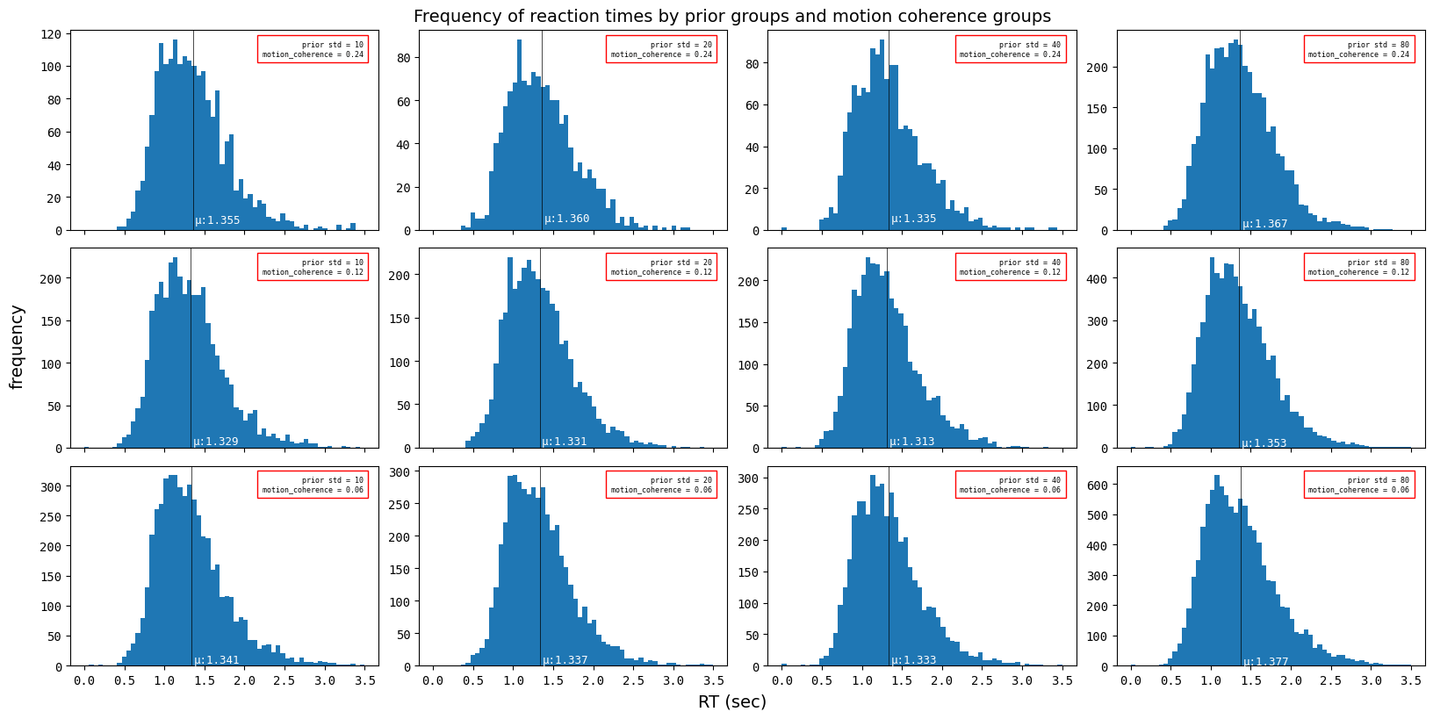
Reaction Time

Slide 11
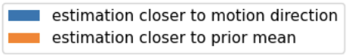
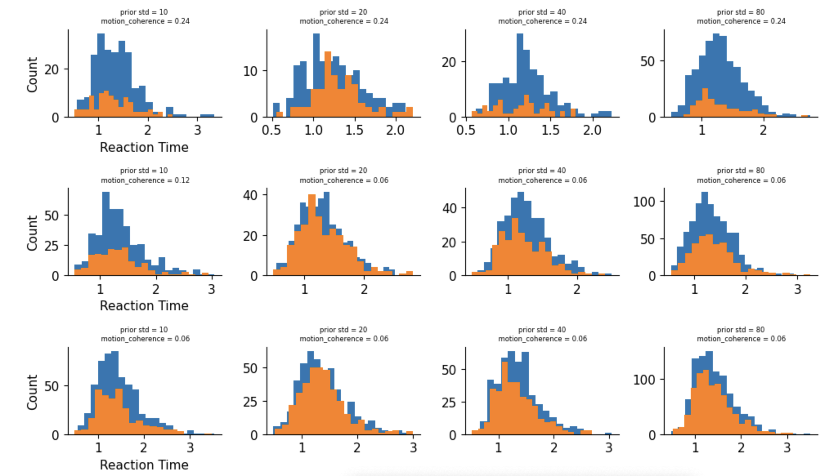
Reaction Time

Slide 12
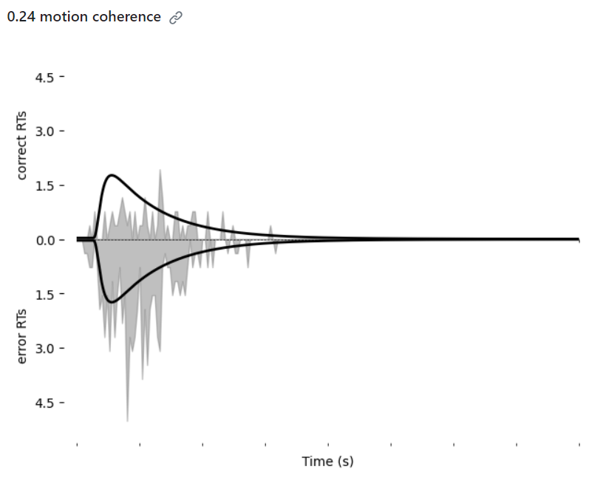
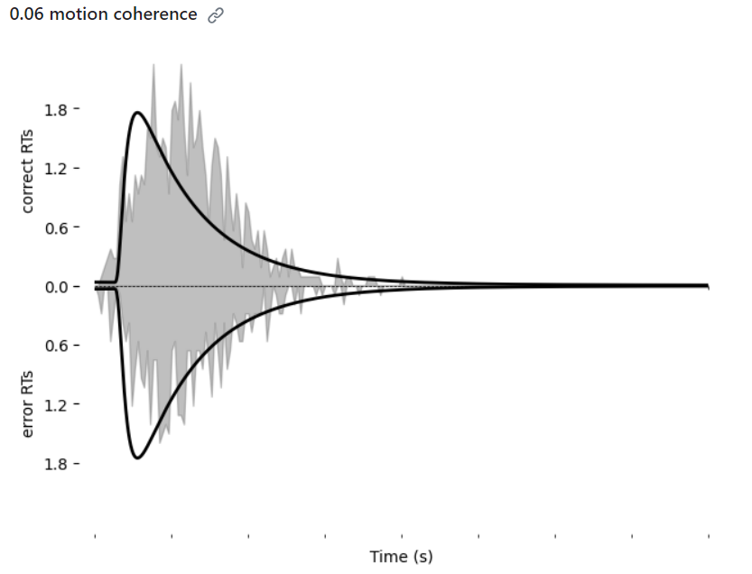
The Drift Diffusion Model (DDM)

Slide 13
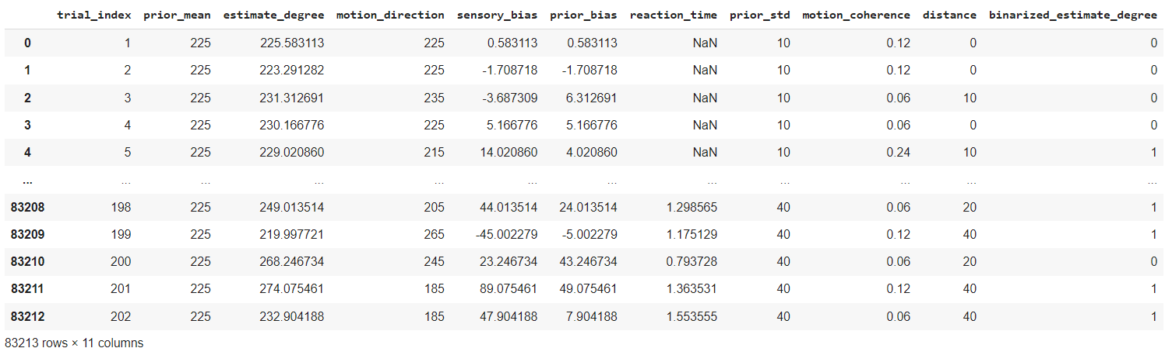
Modeling to find correlation
Logistic Regression
Neural Network

Slide 14
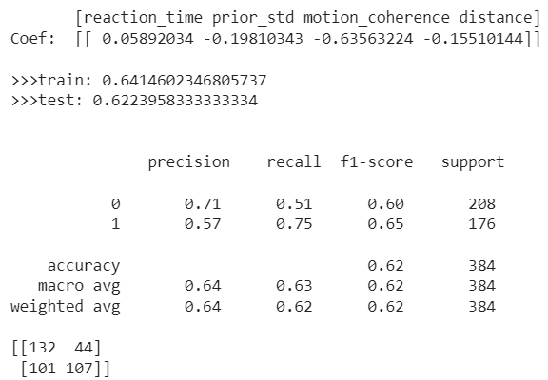
Model Predictions
Binerianzing label
Normalize data
Reform degrees
balance classes

Slide 15
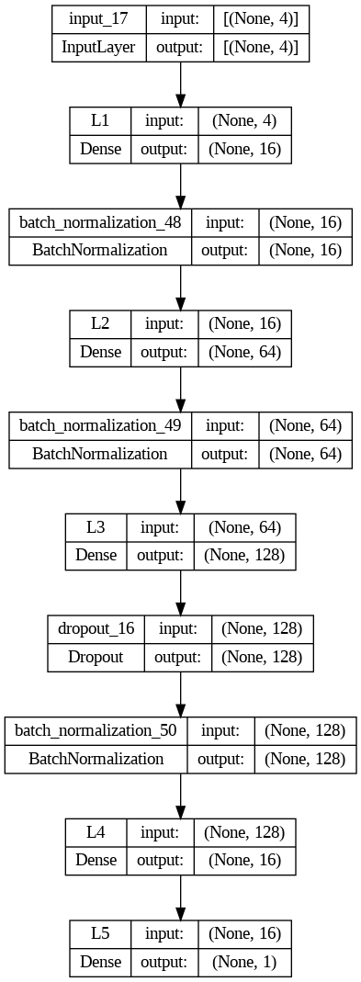
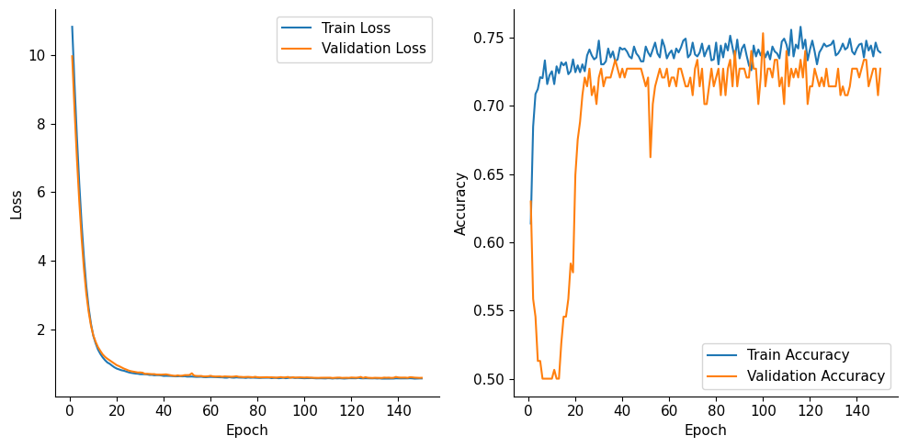
Neural Network
Epoch 150/150 22/22 [==============================] - 0s 7ms/step - loss: 0.5628 - accuracy: 0.7391 - val_loss: 0.5817 - val_accuracy: 0.7273 Test Loss: 0.5301, Test Accuracy: 76.30%

Slide 16
Thank you. Please feel free to ask any questions. 😄

